Slide 1

Suite Software A Hotel Management System
By: Arjun Balaji, Aseal Mohmand, Cristian Cruz, Joel Tharakan, Ryan Nelson, Titus Ayeni, Trankley Mahler

Slide 2

Objective
To create a hotel management system that consolidates different systems into one all-encompassing program

Slide 3
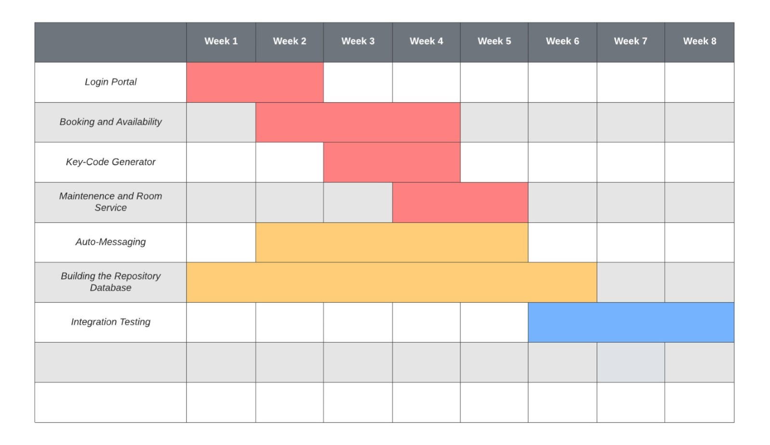
Project Timeline

Slide 4
Cost Estimation
Hardware Price per year | $1,380.00
Estimated Development Cost | $18,218.67
Estimated Maintenance Cost Per Year | $60,000.00
Total | $79,598.67

Slide 5
Functional/Non-functional Requirement
Functional
A user shall gain secure access to the system’s user interface through the Log-in Portal.
A user shall be able to search for available rooms and services for all hotels.
The system shall automatically generate a text message containing the booked room’s keycode.
The user shall be able to request a new keycode to their hotel room during the duration of their stay.
The system shall automatically deliver the text message containing the booked room’s keycode to the requesting customer.
The system shall automatically generate each day, for each formerly occupied room, a list of rooms to be marked unavailable for maintenance.
The user shall be able to request room service and assistance at any time during staff hours.
Non-Functional
Users should be able to access the app on a mobile or desktop device.
Users should be able to book a hotel room in 10 minutes or less.
Auto-messages should be sent to email or SMS within one minute.
Guests' messages should be able to be viewed and responded to by hotel staff within a minute of sending.
Personal information, such as room number, key codes, and payment information, should be secure and only accessible by hotel staff with permission.
Software must be compatible with hotel licensing institutions, as well as local and federal law.

Slide 6
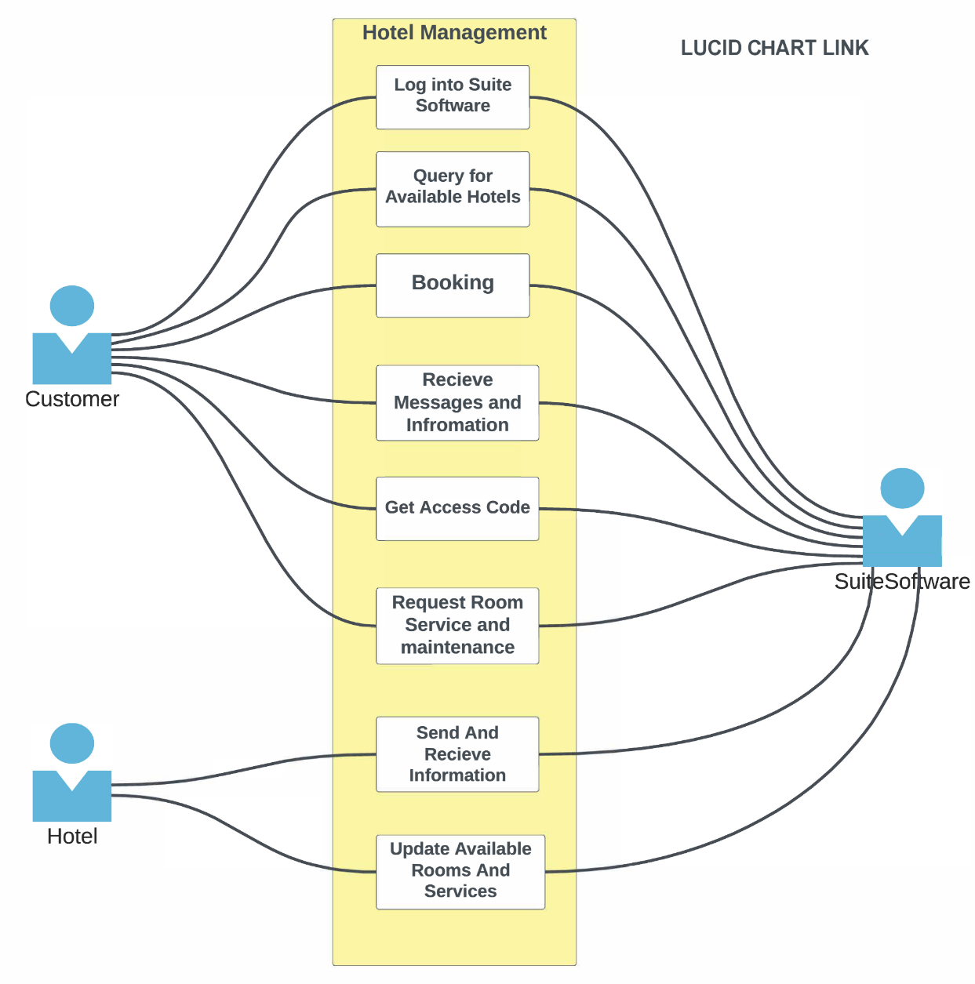
Use Case Diagram

Slide 7
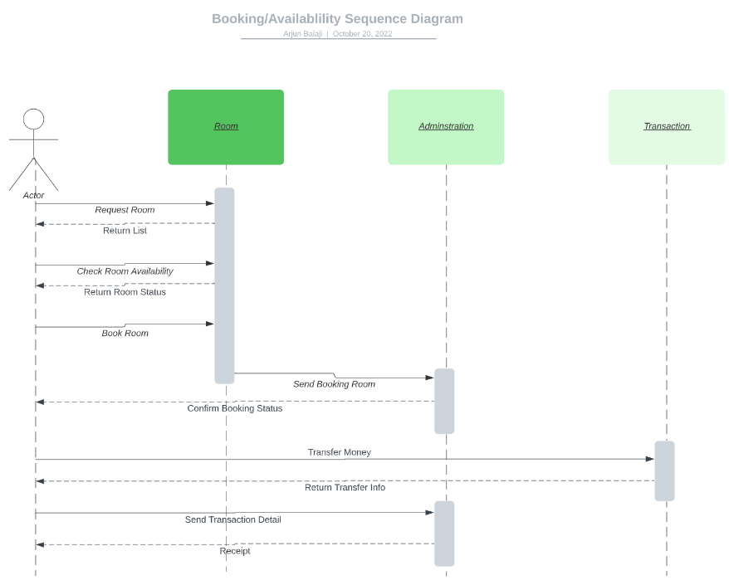
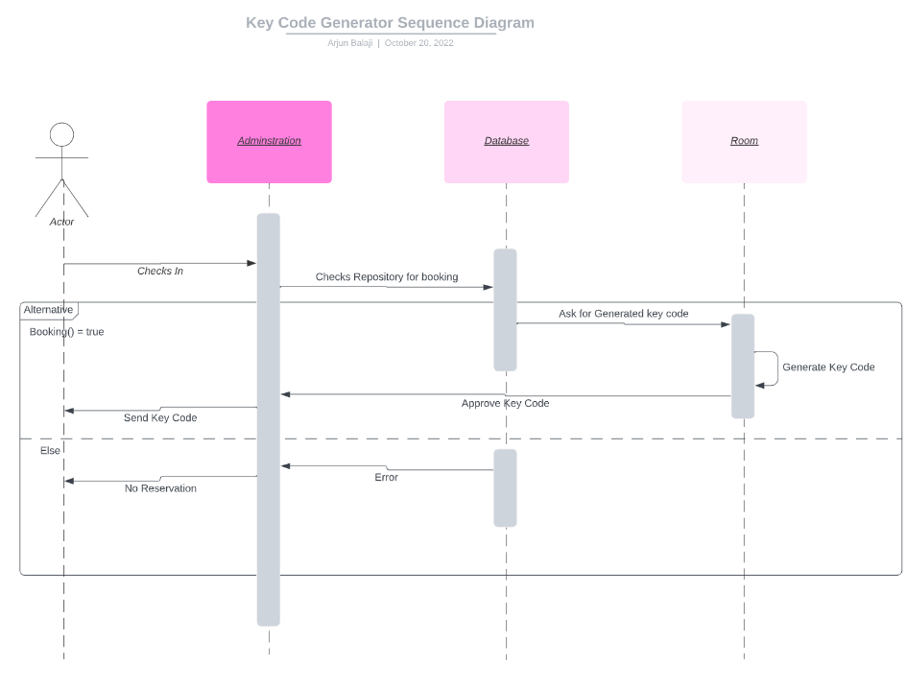
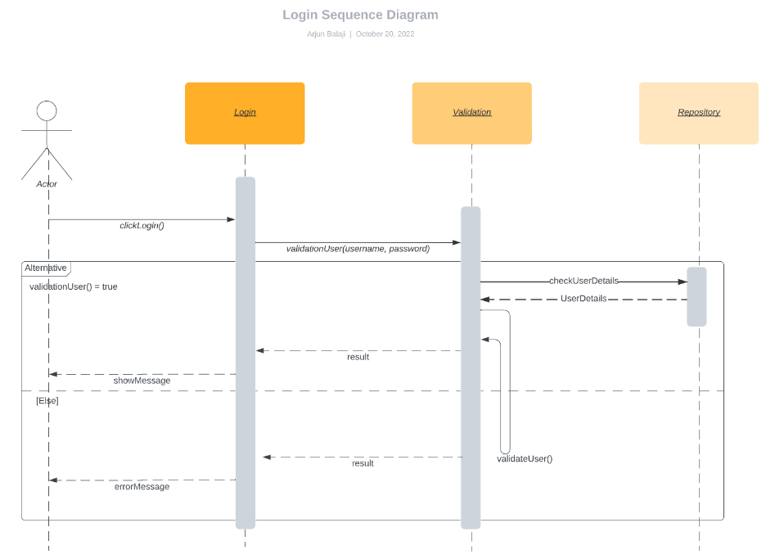
Sequence Diagrams
Booking/Availability
Key-Code Generator
Login Sequence

Slide 8
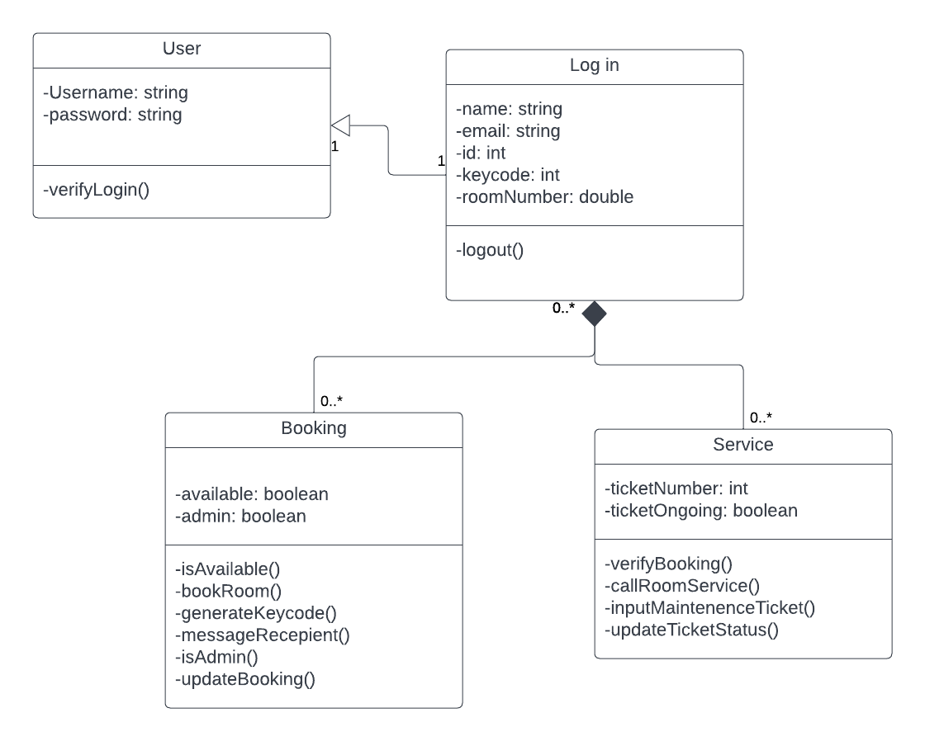
Class Diagram

Slide 9
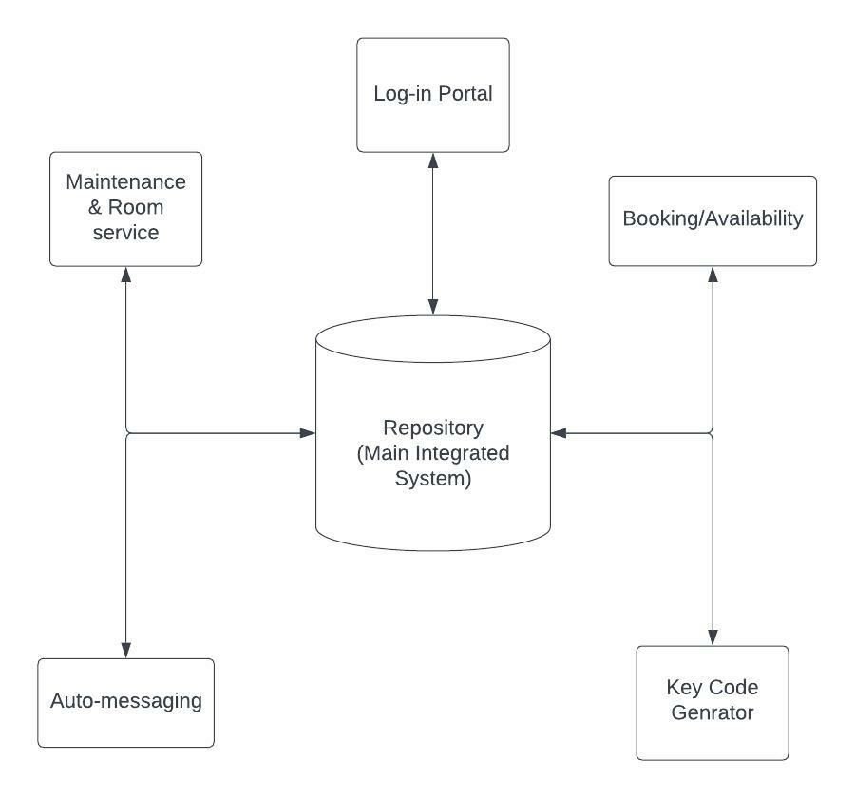
Architecture Design
Repository model

Slide 10
DEMO
Suite Life of Code Figma Link

Slide 11
Works Cited
D. Kopitz and B. Marks, “RDS: The Radio Data System,” Amazon, 1999. [Online]. Available: https://aws.amazon.com/rds/sqlserver/pricing/. [Accessed: 10-Nov-2022].
C. Sarkis, “10 best hotel booking sites for cheap prices (2022),” FamilyVacationist, 20-Oct-2022. [Online]. Available: https://familyvacationist.com/best-hotel-booking-sites-families/. [Accessed: 10-Nov-2022].
B. Khan, M. Arshad, W. Khan, and N. J. Shinwari, “Software cost estimation: Algorithmic and non-algorithmic approaches ...,” Sep-2020. [Online]. Available: https://www.researchgate.net/profile/Bilal-Khan-43/publication/344235082_Software_Cost_Estimation_Algorithmic_and_Non-Algorithmic_Approaches/links/5f7421aea6fdcc0086485d78/Software-Cost-Estimation-Algorithmic-and-Non-Algorithmic-Approaches.pdf?origin=publication_detail. [Accessed: 10-Nov-2022].
“How many lines of code are needed for most websites, apps and ... - quora.” [Online]. Available: https://www.quora.com/How-many-lines-of-code-are-needed-for-most-websites-apps-and-software-programs. [Accessed: 10-Nov-2022].
“Free Editable Hotel Floor Plans”, Wondershare Edraw Max.” [Online]. Available: https://www.edrawmax.com/article/hotel-floor-plan.html . [Accessed: 10-Nov-2022].

